Slide 1
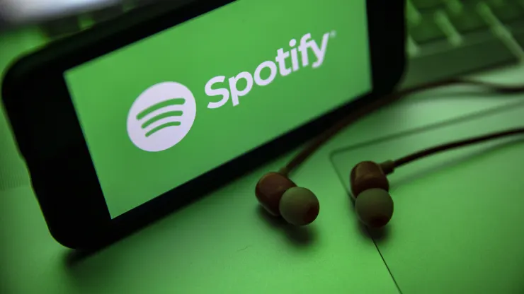

Recipe for Hit Songs
Data Science for Business Term Project
Team 23
Ahmet Tas
Alexandra Wang
Rashmi Gehi
Sarah Guo
Tushar Pandey

Slide 2
Outline
Business Problem & Use Scenario
Exploratory Data Analysis
Data Mining & Model Evaluation
Deployment

Slide 3
Business Problem & Use Scenario

Slide 4
We intend to use proposed model to help suggest key song features to gauge popularity for the producers to make money
250 streams = $1 for the producer
Popularity is the key
What is the perfect balance of danceability, energy, tempo, valence, loudness, duration, and other factors that can ensure a song’s popularity?
Use Scenario
The producers will be able to gauge and quantify the dependency of song features on song popularity with the model we proposed.

Slide 5
Exploratory Data Analysis

Slide 6
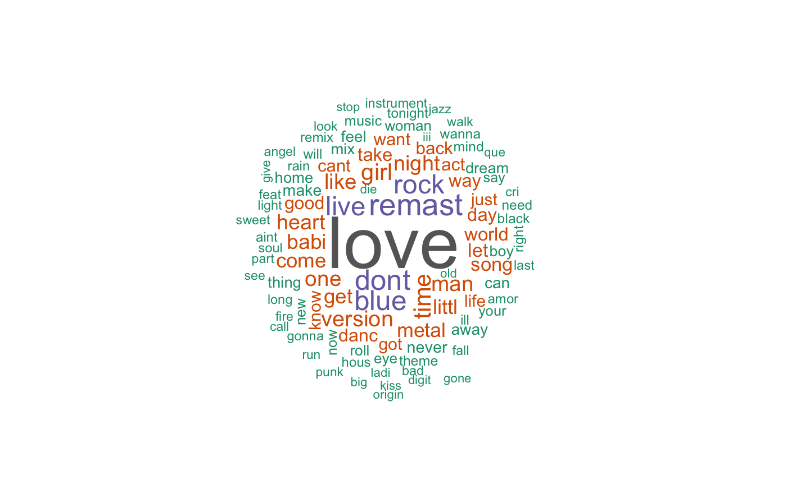
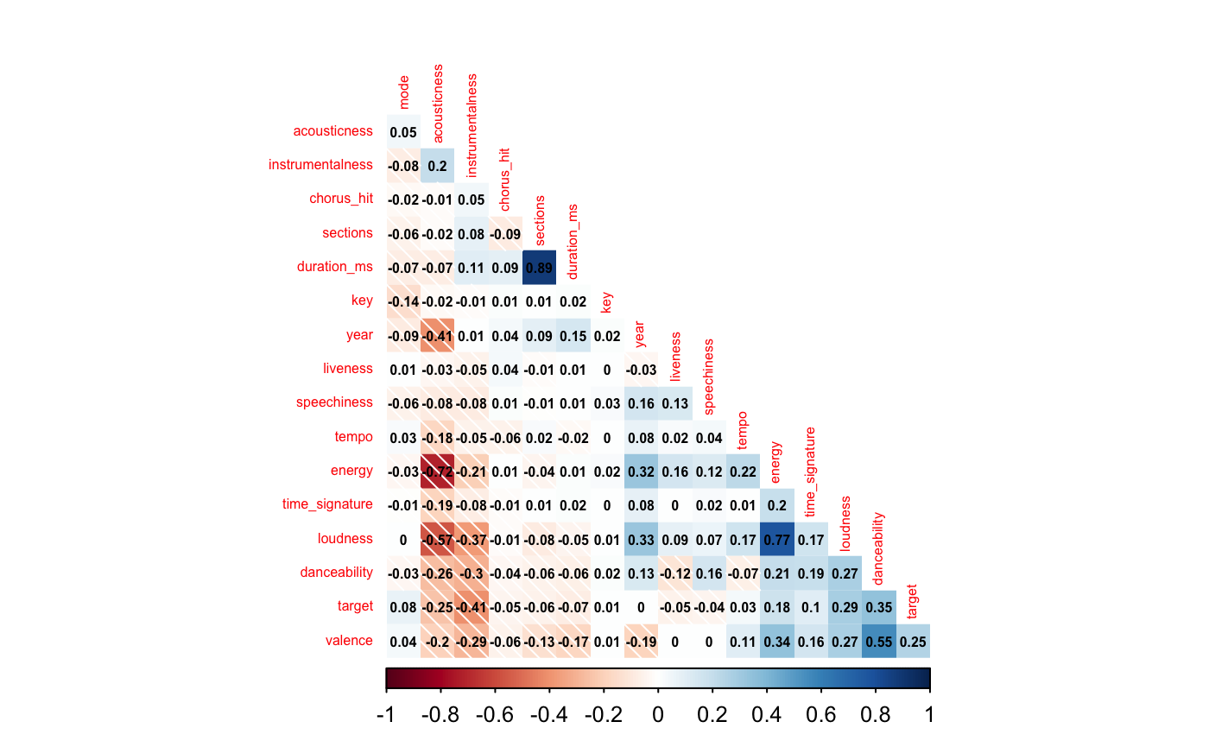
“Love” is the most used word in song titles, and the high correlations between variables drove our further exploration
We focused on exploring variables with high correlation absolute values and 0 correlation
InsightsInsights
Insights
Insights
The word cloud shows that “love” is the most used word in song titles, followed by “don’t”, “rock”, “live”, “blue”, and “remast”

Slide 7
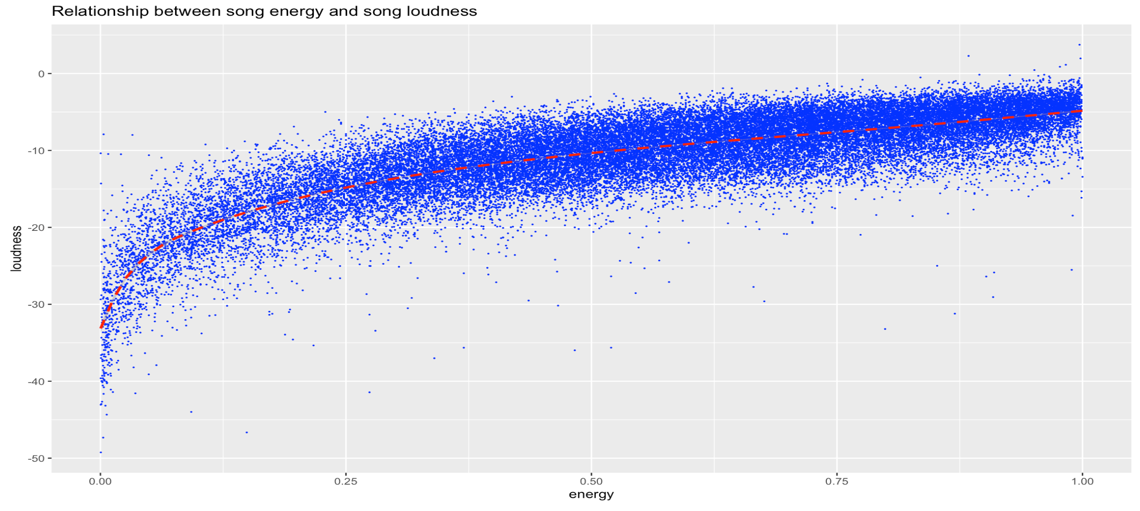
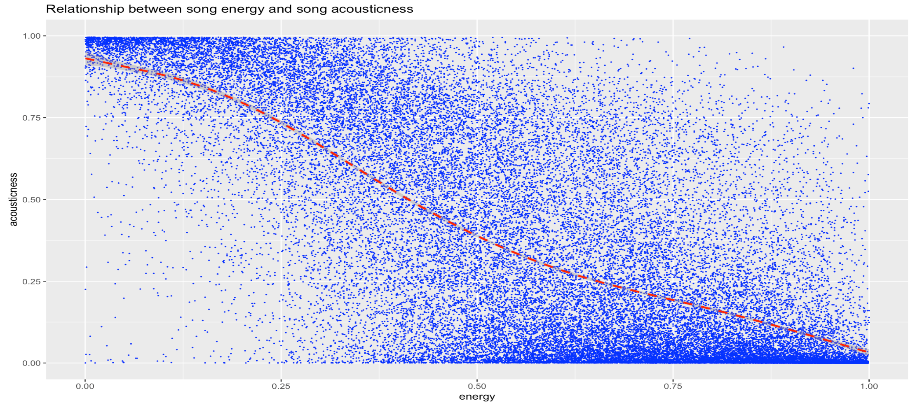
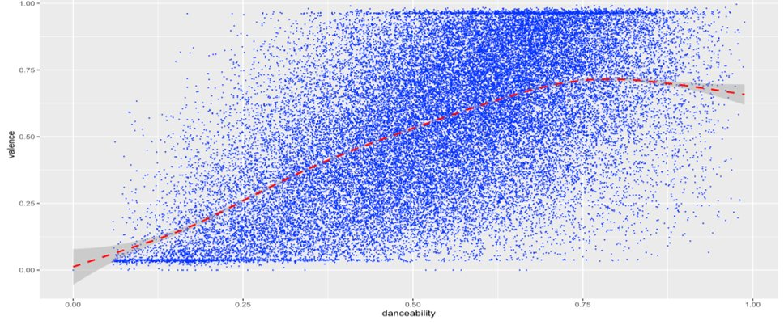
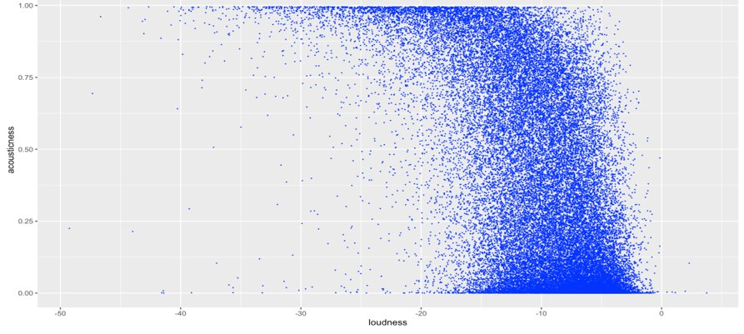
The plots proved the high correlation between the song features present in the data
Relationship between Song Energy and Song Loudness
Relationship between Song Energy and Song Acousticness
Relationship between Song Danceability and Song Valence
Relationship between Song Loudness and Song Acousticness

Slide 8
Data Mining & Model Evaluation

Slide 9
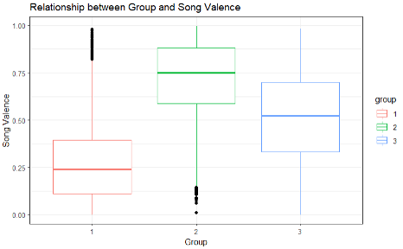
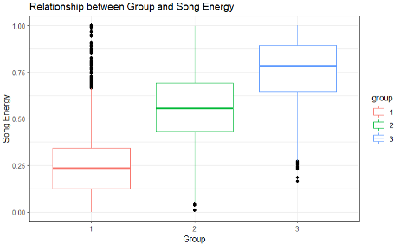
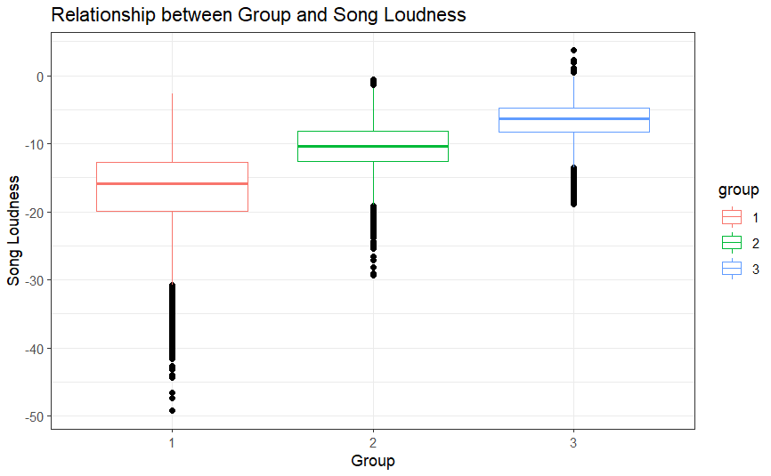
With K-Means Clustering, 3 clusters could segregate the songs into distinct groups with similar characteristics
Group 1 – Sad Songs
Less energy, low valence
(sad) songs
Group 2 – Dance Songs
High energy, high valence (happy) songs
Group 3 – Loud Songs
High energy, high loudness songs

Slide 10
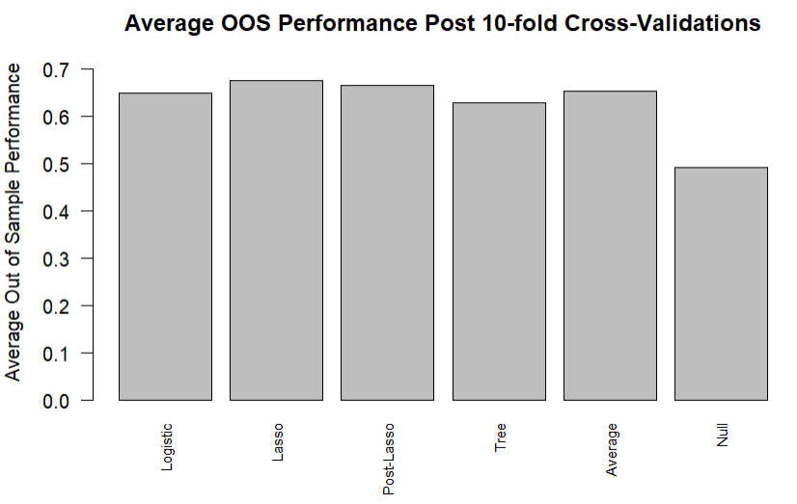
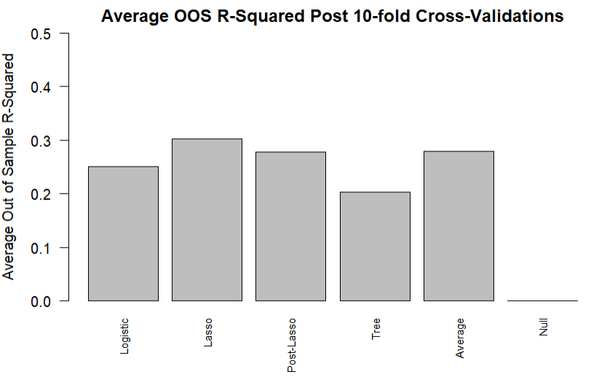
Further tests on Lasso reduction model shows that it has high accuracy in prediction
We have achieved close to 70% OOS accuracy with our lasso model
We have achieved close to 32% OOS R-squared with our lasso model

Slide 11
Lasso reduction model has the maximum AUC hence the best model for prediction

Slide 12
We can’t afford to predict false on the songs which are hit songs
Threshold Value | FPR | TPR | ACC | TP | FP | FN | TN
0.25 | 0.52 | 0.97 | 0.73 | 19,879 | 10,604 | 674 | 9,949
0.45 | 0.35 | 0.89 | 0.77 | 18,326 | 7,158 | 2,227 | 13,395
0.50 | 0.31 | 0.85 | 0.77 | 17,495 | 6,271 | 3,058 | 14,282
0.75 | 0.09 | 0.42 | 0.67 | 8,679 | 1,758 | 11,874 | 18,795
Our priority is predicting hit songs
We optimize on True Positive Rate
We choose the threshold value as 0.45

Slide 13
Lasso results explain the effects of the feature of the songs on popularity
Song Feature
Song Description
Effect on Popularity
Speechiness &
(instrumentalness OR energy)
Wordy Energy Songs
Energy &
(acousticness OR danceability)
Electronic dance Songs
Valence &
(instrumentalness OR energy)
Happy vibe songs
We used the absolute value of the coefficients (betas) to identify if a song’s popularity increases or decreases

Slide 14
Deployment

Slide 15
Our model will change the industry dynamics
FOR Songwriters, Producers, and Artists
"How to guarantee a hit song?"
Record labels can leverage the clusters to appeal to different demographics

Slide 16
Potential risks and our solution plans come together
1
Desire to be popular will cause a very high demand
Minimizing access to our model
2
Many songs have the potential to sound the same
Many attribute options
3
Artists’ fame plays an important factor
Exception songs popularity

Slide 17
Thanks!

Slide 18
Appendix

Slide 19
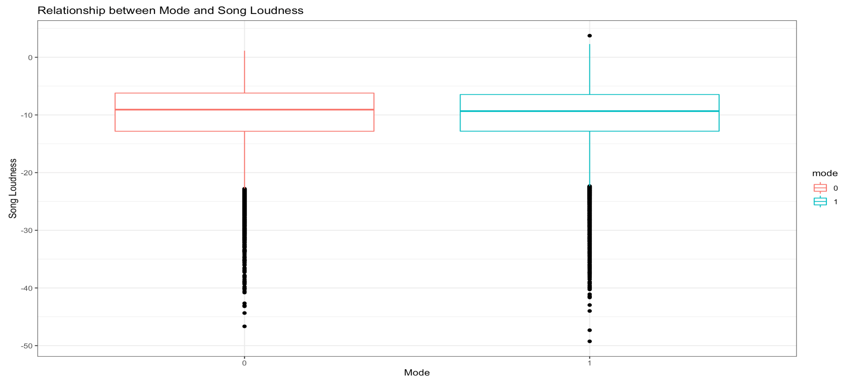
Relationship between Mode and Song Loudness

Slide 20
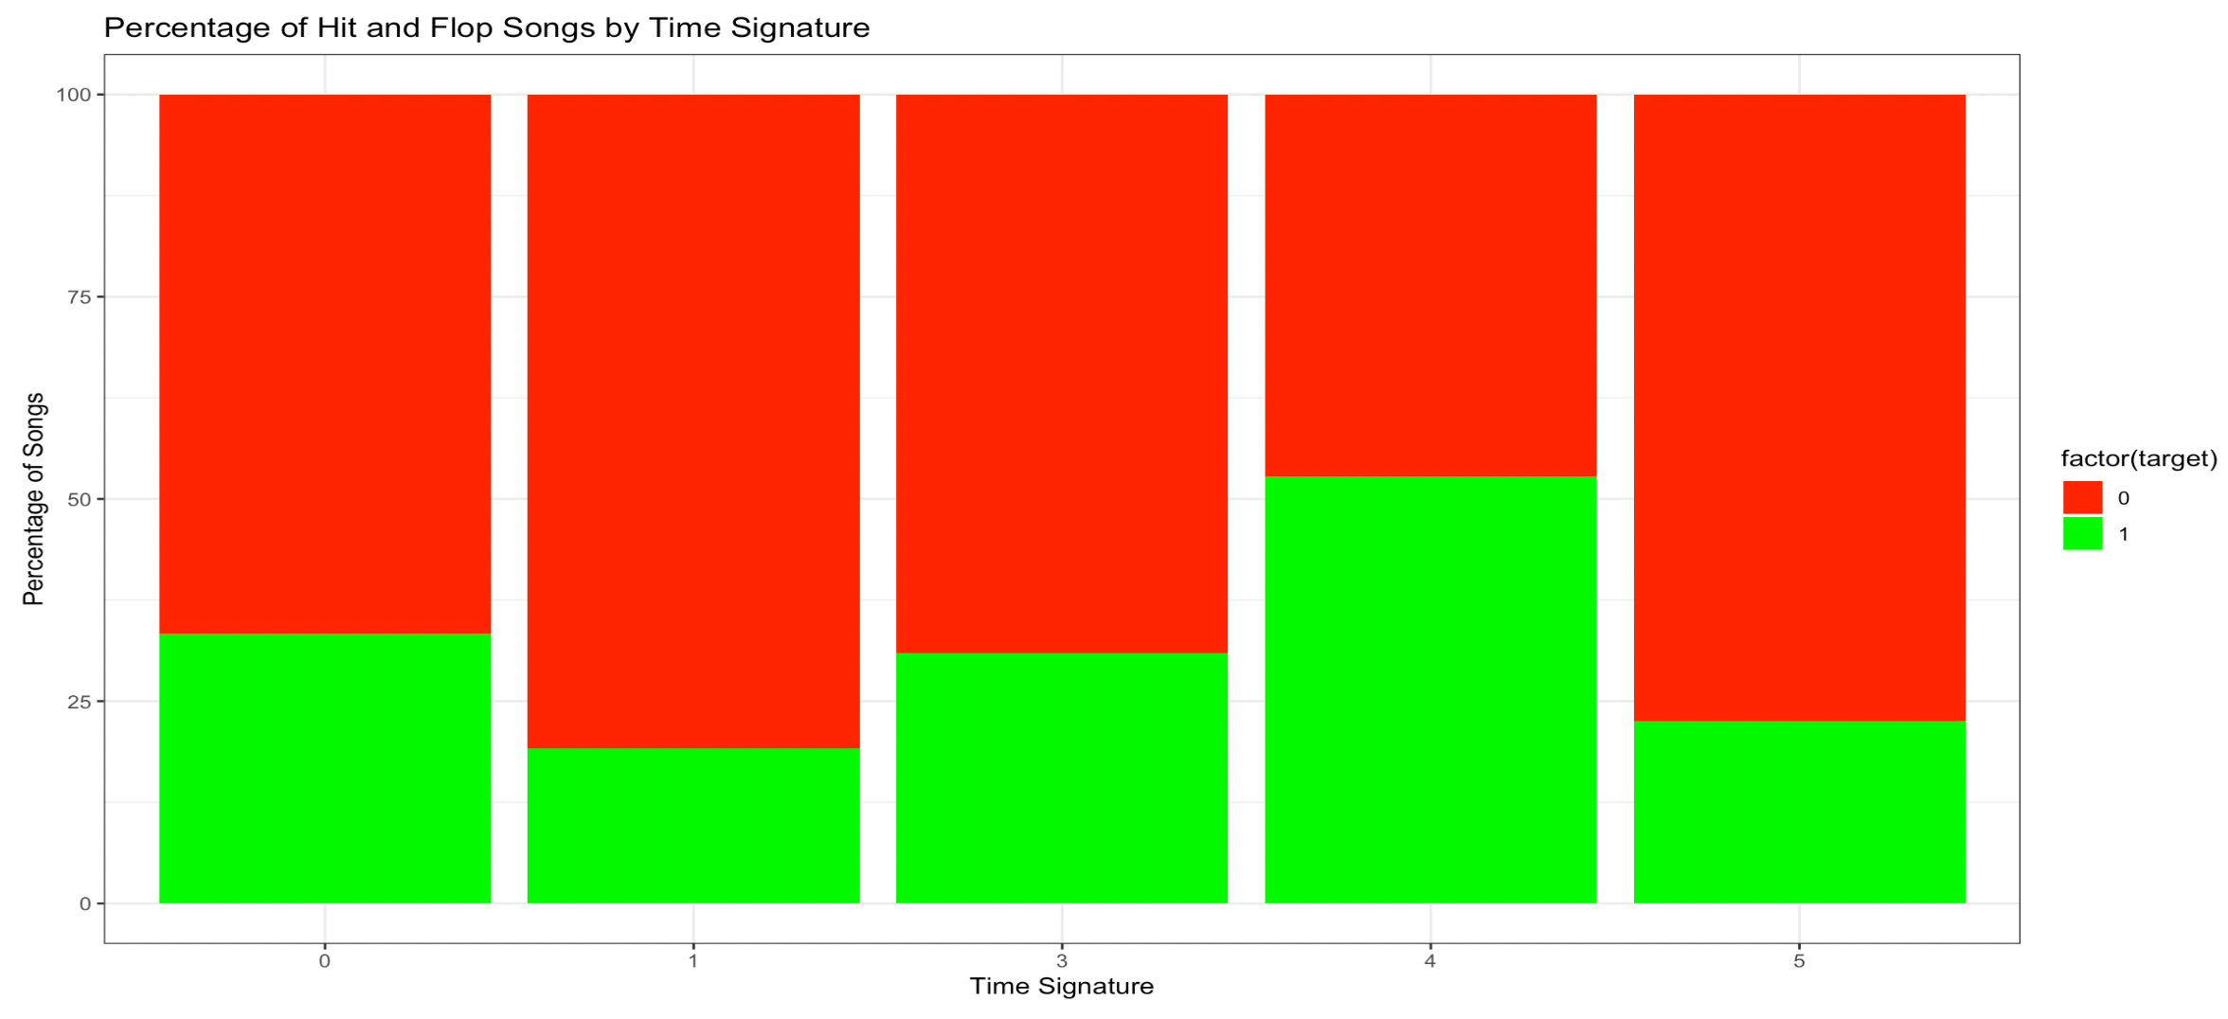
Percentage of Hit and Flop Songs by Time Signature

Slide 21
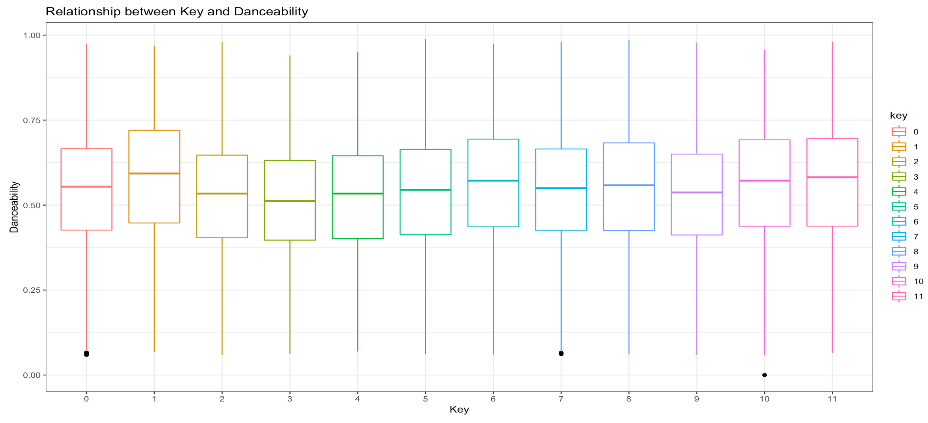
Relationship Between Key and Danceability

Slide 22
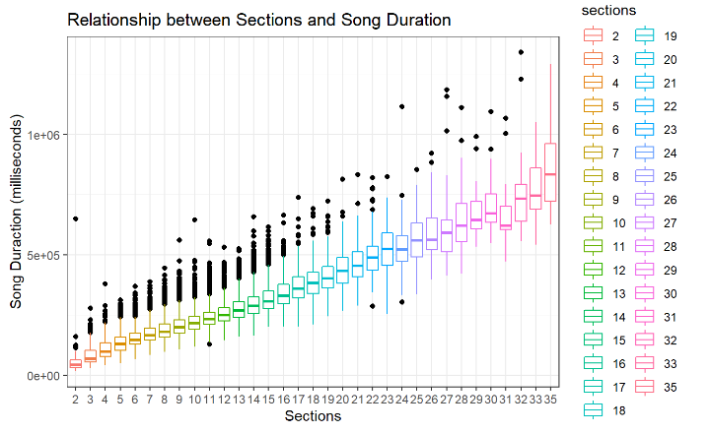
Relationship Between Sections and Song Duration

Slide 23
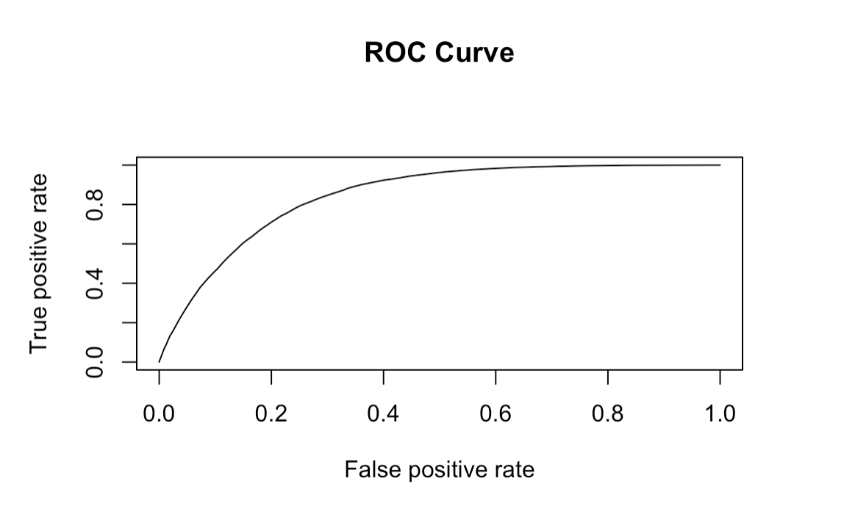
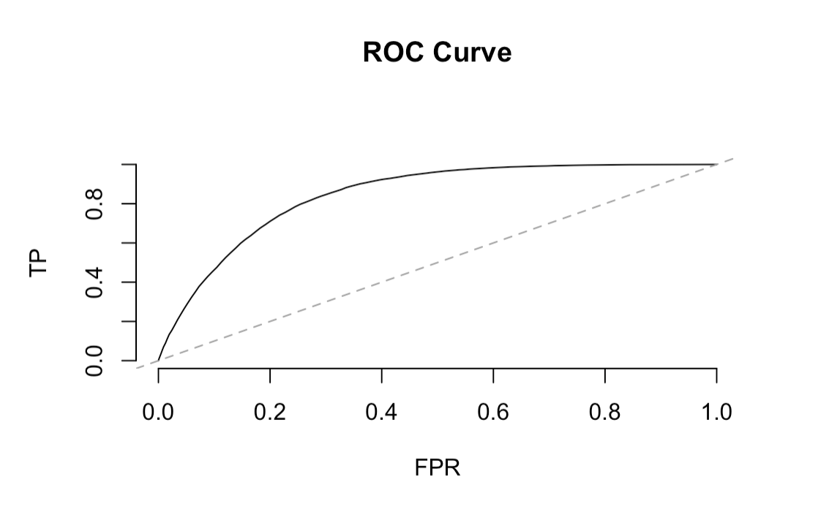
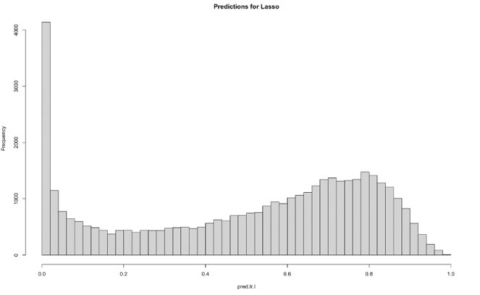
Modeling

Slide 24
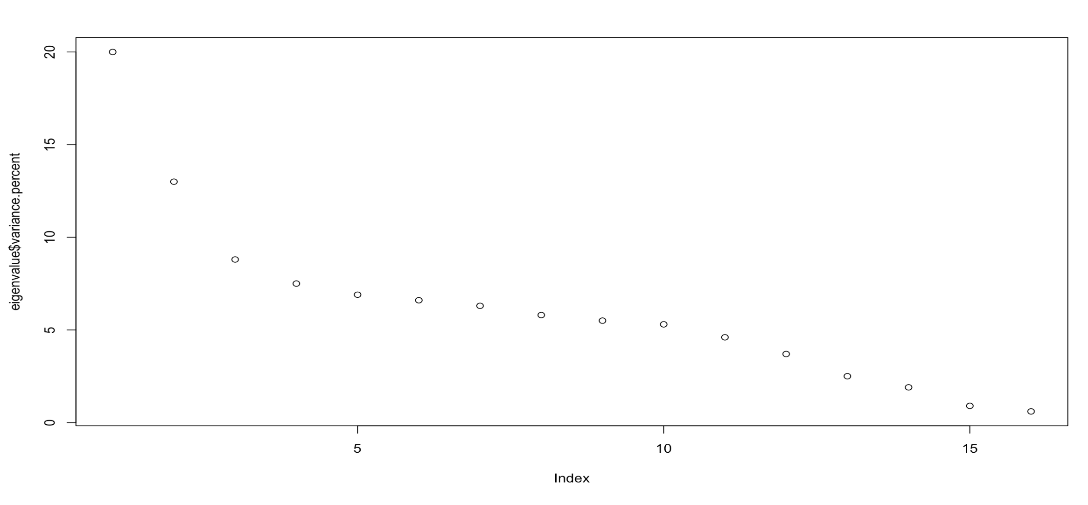
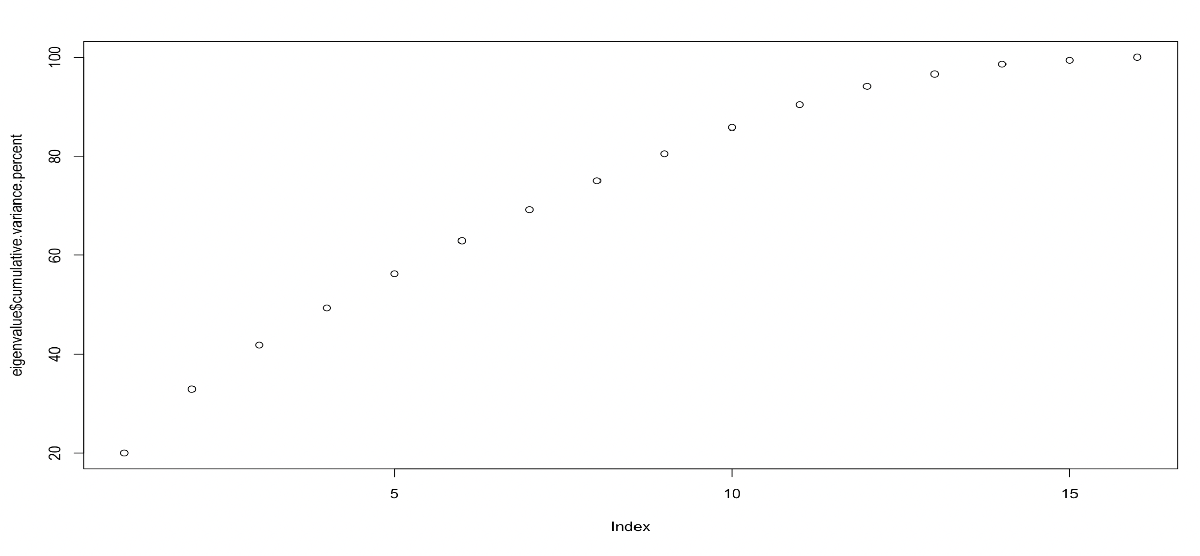
Modeling

Slide 25
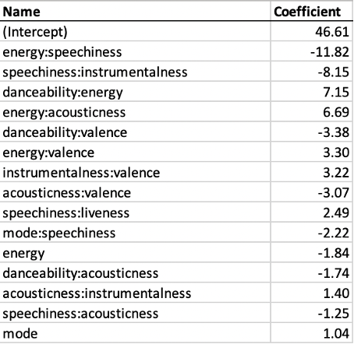
Interactions

Slide 26
Lasso results explain the effects of the feature of the songs on popularity
Song Feature 1
Song Feature 2
Effect on Popularity
Song
Speechiness
instrumentalness or energy
High Energy Songs
Energy
acousticness or danceability
Electronic Dance Music
Valence
instrumentalness or energy
Happy Vibe Songs

